Slide 1

Multimedia
Vorlesung
Hannes Kaufmann
Hannes Kaufmann
Virtual & Augmented Reality Group Research Unit Computer Graphics
Institute of Visual Computing & Human-Centered Technology
Based on material by Prof. Christian Breiteneder

Slide 2
Psychoacoustics
Hannes Kaufmann
Scientific study of sound perception and audiology: How humans perceive various sounds
Study on your own the Youtube course “Psychoakustik” (German)
https://www.youtube.com/watch?v=8_TxY93L8xE&list=PLftcEygAp_6Ik8Sp KNesLim_omxfXMbmo&index=1
11 parts, ~ 107 min (total)

Slide 3
Inverted Classroom: Psychoacoustics Questions
Hannes Kaufmann
How do we hear?
What happens inside the cochlea?
What are the different ways to judge the location & direction of sound?
What is 1 MEL? What is 1 BARK?
What is critical bandwidth?
How large is a critical band?
What is the connection between critical bands and hair cells?

Slide 4
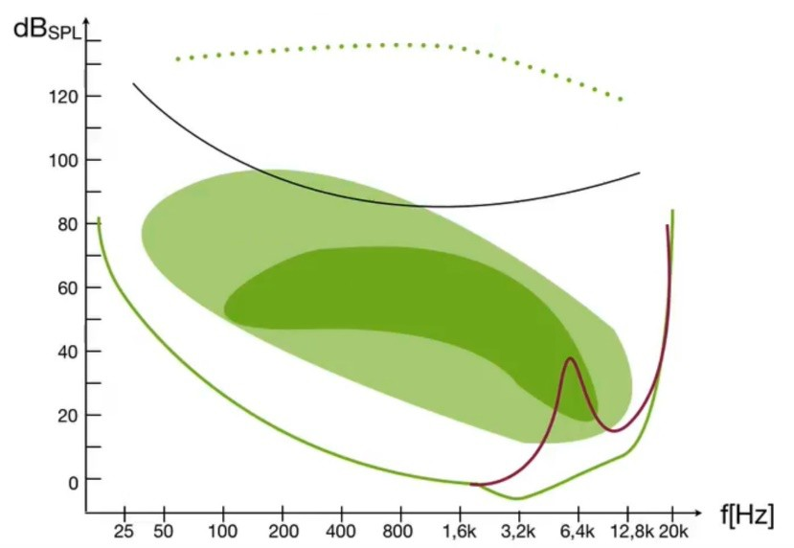
Inverted Classroom: Psychoacoustics Questions
Hannes Kaufmann
Explain and annotate the figure ->
What is masking?
What is temporal masking?
Describe a psychoacoustic phenomenon (e.g. Shepard Scala, Tritonus Paradoxon,…)

